Slide 1

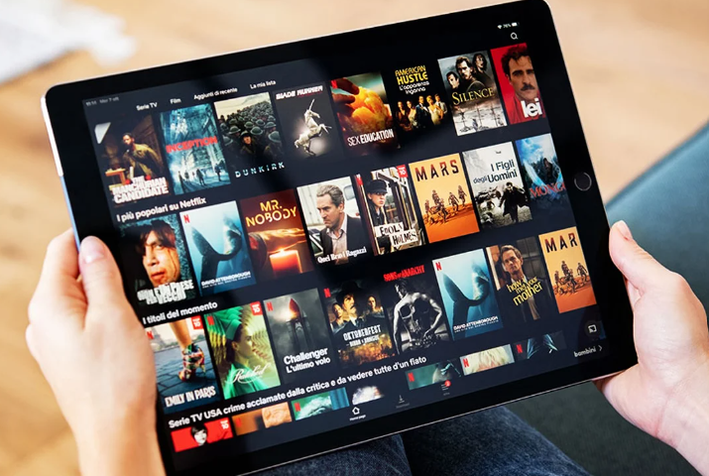
The Impact of Disney + Hotstar: Case Study
Exploring the evolution, strategies and future potential of Disney + Hotstar in the entertainment industry.

Slide 2
Overview of Disney + Hotstar Disney+ Hotstar is a popular OTT platform offering a mix of Disney content and local shows, catering to diverse audience preferences.
Ownership and International Reach
Owned by Disney, Disney+ Hotstar has a wide international presence, providing exclusive access to Disney-owned content globally.
Position in the OTT Market
Disney+ Hotstar holds a significant position in the competitive OTT market, offering a unique blend of international and regional content.
Primary Goals and Objectives
The case study focuses on analyzing Disney+ Hotstar's strategic goals and objectives, shedding light on its growth trajectory and success factors.
OTT Market Analysis
Introduction to Disney + Hotstar
Exploring the influence and reach of Disney + Hotstar in OTT platform

Slide 3
EVOLUTION TIMELINE
EVOLUTION OF DISNEY+ HOTSTAR
2015
Launch of Disney+ Hotstar, marking the beginning of its journey
2017-2019
Introduction of key milestones and significant expansions in content and services
2020-2021
Rapid growth trajectory and substantial market penetration, solidifying its presence
Ongoing
Recognition and achievements in the industry, establishing Disney+ Hotstar as a major player
Exploring the Impact and Growth of Disney+ Hotstar

Slide 4
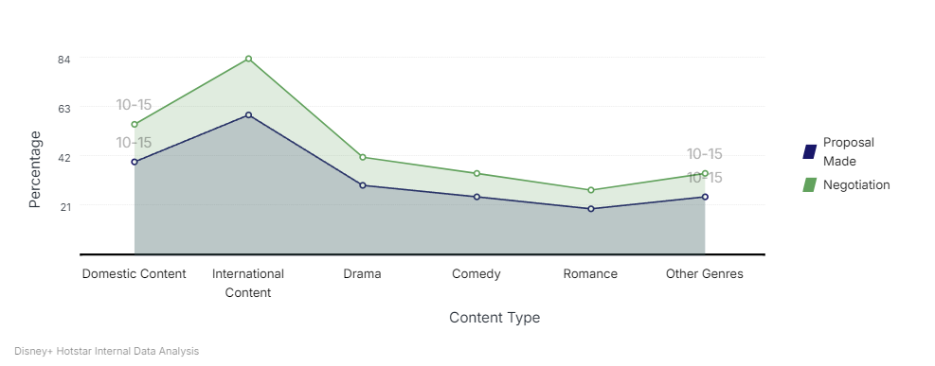
CONTENT DISTRIBUTION ANALYSIS
CONTENT STRATEGY AND OFFERINGS Analyzing the Content Diversity and Strategy of Disney+ Hotstar

Slide 5
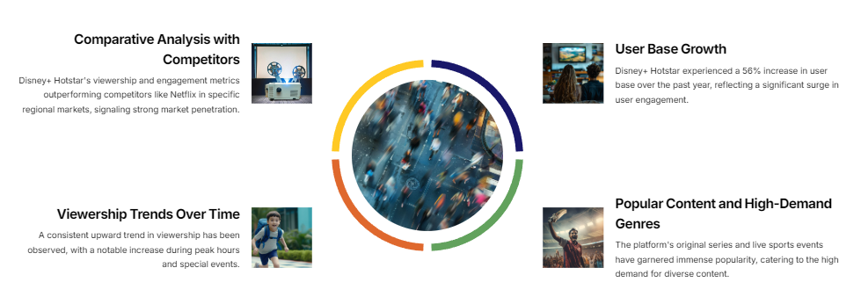
USER ENGAGEMENT INSIGHTS
USER ENGAGEMENT AND POPULARITY
The Impact of Disney+ Hotstar: A Case Study

Slide 6
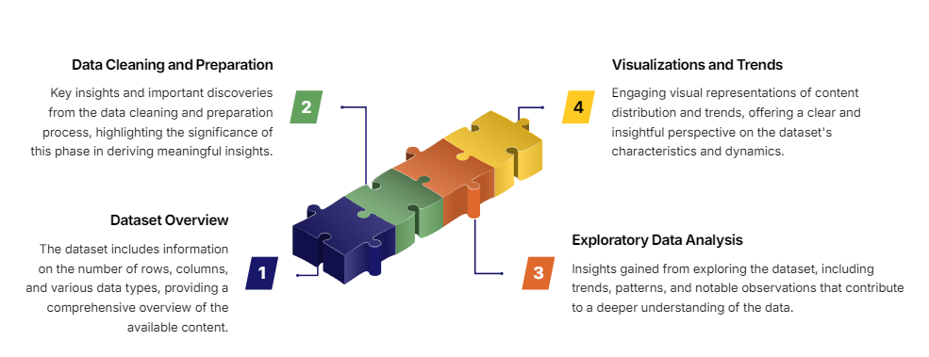
DATA INSIGHTS
DATA ANALYSIS AND INSIGHTS
Understanding the Impact of Disney+ Hotstar through Data Analysis

Slide 7
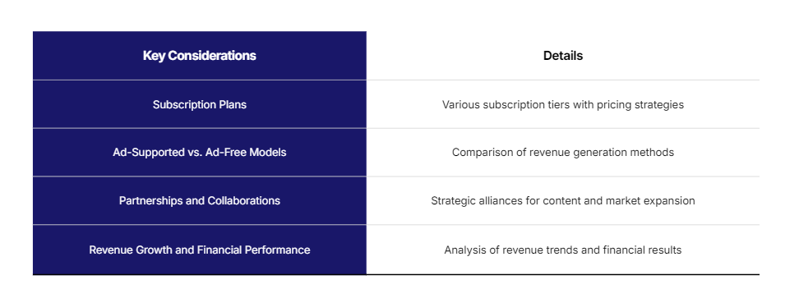
REVENUE MODEL ANALYSIS
BUSINESS AND REVENUE MODELS
Analyzing Subscription Plans, Partnerships, and Financial Performance

Slide 8
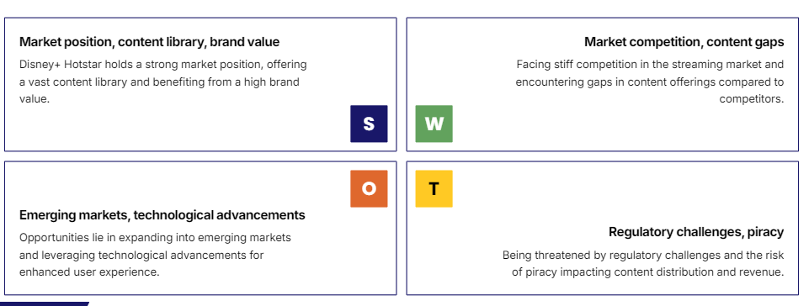
STREAMING MARKET ANALYSIS
SWOT ANALYSIS OF DISNEY+ HOTSTAR
Analyzing the Strengths, Weaknesses, Opportunities, and Threats of Disney+ Hotstar in the Streaming Market

Slide 9
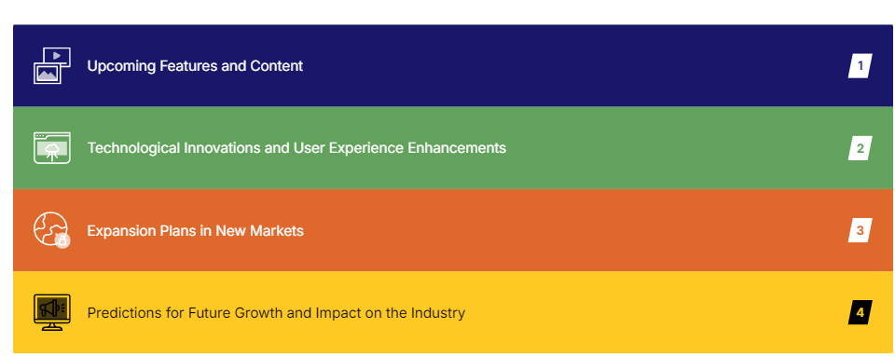
INNOVATIONS & IMPACT
FUTURE POTENTIAL AND INNOVATIONS
Exploring the Impact of Disney+ Hotstar through Future Innovations

Slide 10
Thank you

